Slide 1
Instructor Materials Chapter 3: Network Protocols and Communications
CCNA Routing and Switching
Introduction to Networks v6.0
Notes:
Cisco Networking Academy Program
Introduction to Networks v6.0
Chapter 3: Network Protocols and Communications

Slide 2
Chapter 3: Best Practices (Cont.)
Section 3.2
Explain the role of protocols in facilitating interoperability in network communications.
Discuss protocols generally and how they are used in networking.
TCP/IP - Students need to memorize the layers, their functions, and what protocols are found at each layer.
Discuss the interaction between a user and a web server. Use the animation on page 3.2.2.4
Activity 3.2.2.5 - This is a good activity to reinforce information provided in this section.
Discuss the advantages and disadvantages of a standards-based protocol and a proprietary protocol.

Slide 3
Chapter 3: Network Protocols and Communications
CCNA Routing and Switching
Introduction to Networks v6.0
Notes:
Cisco Networking Academy Program
Introduction to Networks v6.0
Chapter 3: Network Protocols and Communications

Slide 4
Chapter 3 - Sections & Objectives
3.1 Rules of Communication
Describe the types of rules that are necessary to successfully communicate.
3.2 Network Protocols and Standards
Explain why protocols are necessary in communication.
Explain the purpose of adhering to a protocol suite.
Explain the role of standards organizations in establishing protocols for network interoperability.
Explain how the TCP/IP model and the OSI model are used to facilitate standardization in the communication process.
3.3 Data Transfer in the Network
Explain how data encapsulation allows data to be transported across the network.
Explain how local hosts access local resources on a network.
Notes:
4

Slide 5
3.1 Rules of Communication
Notes:
Cisco Networking Academy Program
Introduction to Networks v6.0
Chapter 3: Network Protocols and Communications

Slide 6
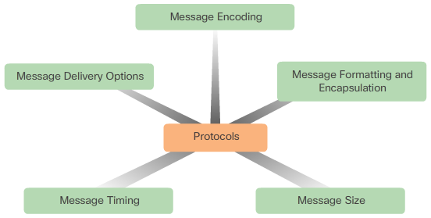
Rules of Communication The Rules
Rule Establishment
Identified sender and receiver
Common language and grammar
Speed and timing of delivery
Confirmation or acknowledgment requirements
Message Encoding
Process of converting information into another acceptable form
Message Formatting and Encapsulation
Message Size
Message Timing
Access method
Flow control
Response timeout
Message Delivery Options
Unicast
Multicast
Broadcast
Notes:
3.1 – Rules of Communication
3.1.1 – The Rules

Slide 7
3.2 Network Protocols and Standards
Notes:
Cisco Networking Academy Program
Introduction to Networks v6.0
Chapter 3: Network Protocols and Communications

Slide 8
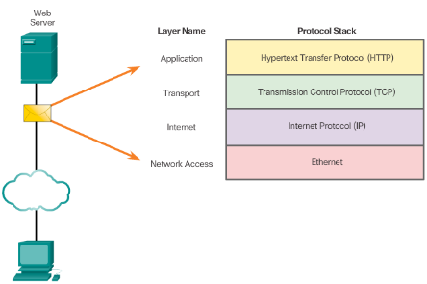
Network Protocols and Standards Protocols
Rules that Govern Communications
Network Protocols
The role of protocols
How the message is formatted or structured
The process by which networking devices share information about pathways with other networks
How and when error and system messages are passed between devices
The setup and termination of data transfer sessions
Protocol Interaction
Example: web server and client
Notes:
3.2 – Network Protocols and Standards
3.2.1 – Protocols

Slide 9
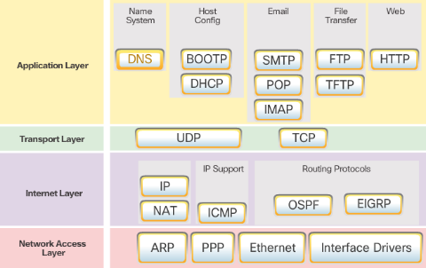
Network Protocols and Standards Protocol Suites
Protocol Suites and Industry Standards
TCP/IP is an open standard
Can you name other protocol suites?
TCP/IP Protocol Suites
Can you name some of the protocols from the TCP/IP protocol suite.
TCP/IP Communication Process
Can you describe the process?
Notes:
3.2 – Network Protocols and Standards
3.2.2 – Protocol Suites

Slide 10
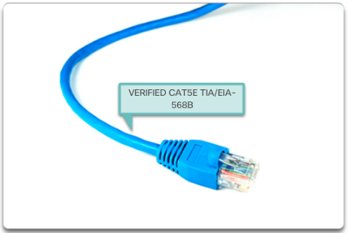
Network Protocols and Standards Standard Organizations
Open Standards
Name some advantages of open standards
Internet Standards
Name a few standard organizations
Electronics and Communications Standards Organizations
Name a few organizations
Notes:
3.2 – Network Protocols and Standards
3.2.3 – Standard Organizations

Slide 11
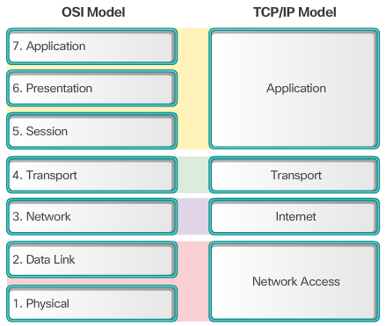
Network Protocols and Standards Reference Models
The Benefits of Using a Layered Model
Name some benefits
The OSI Reference Model
Provides list of functions
Describes interactions between layers
OSI Model and TCP/IP Model Comparison
Similar: transport and network layers
Contrast: relationship between layers
Notes:
3.2 – Network Protocols and Standards
3.2.4 – Reference Models

Slide 12
3.3 Data Transfer in the Network
Notes:
Cisco Networking Academy Program
Introduction to Networks v6.0
Chapter 3: Network Protocols and Communications

Slide 13
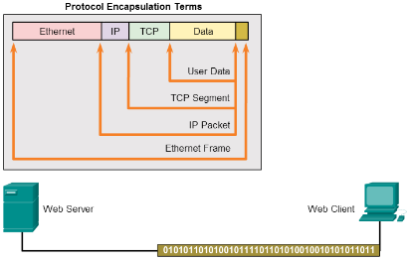
Data Transfer in the Network Data Encapsulation
Message Segmentation
Segmentation - Break communication into pieces
Multiplexing – interleaving the pieces
Protocol Data Units
What are PDUs called at each layer?
Encapsulation and de-encapsulation process
Notes:
3.3 – Data Transfer in the Network
3.3.1 – Data Encapsulation

Slide 14
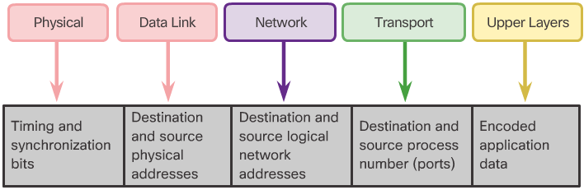
Data Transfer in the Network Data Access
Network Addresses
Source IP address
Destination IP address
Deliver the IP packet from the original source to the final destination, either on the same network or to a remote network.
Data Link Addresses
Source data link address
Destination data link address
Deliver the data link frame from one network interface card (NIC) to another NIC on the same network
Devices on the Same Network
Devices on a Remote Network
Notes:
3.3 – Data Transfer in the Network
3.3.2 – Data Access

Slide 15
3.4 Chapter Summary
Notes:
Cisco Networking Academy Program
Introduction to Networks v6.0
Chapter 3: Network Protocols and Communications

Slide 16
Chapter Summary Summary
Explain how rules are used to facilitate communication.
Explain the role of protocols and standards organizations in facilitating interoperability in network communications.
Explain how devices on a LAN access resources in a small to medium-sized business network.
Notes:
3.4.1.4 - Summary

